Slide 1
TDP-43 Pathology
TDP-43 pathology is present in many neurodegenerative disorders, is the result of various mutations, and is evident in multiple tissues
What dysregulated genes and pathways do these conditions have in common?
Could this point towards a causative mechanism of TDP-43 pathology?

Slide 2
DEG datasets
Genetic Background | Disease | Platform
C9orf72 | Amyotrophic lateral sclerosis | Microarray
CHMP2B | Amyotrophic lateral sclerosis | Microarray
Sporadic | Amyotrophic lateral sclerosis | Microarray
C9orf72 + Sporadic | Amyotrophic lateral sclerosis | RNA-seq
Sporadic | Amyotrophic lateral sclerosis | RNA-seq
GRN + Sporadic | Frontotemporal lobar degeneration | Microarray
VCP | Inclusion body myopathy | Microarray

Slide 3
Differential gene expression analysis
Compares expression levels of individual genes between case and control
Microarray and RNA-seq – 62 cases, 41 controls
Generated list of 178 commonly differentially expressed genes
Notes:
4 genes linked to ALS by RNA expression, 2 to AD
Approximately half of the genes come from a gene family in which another protein has been linked to a TDP-43 associated disease

Slide 4
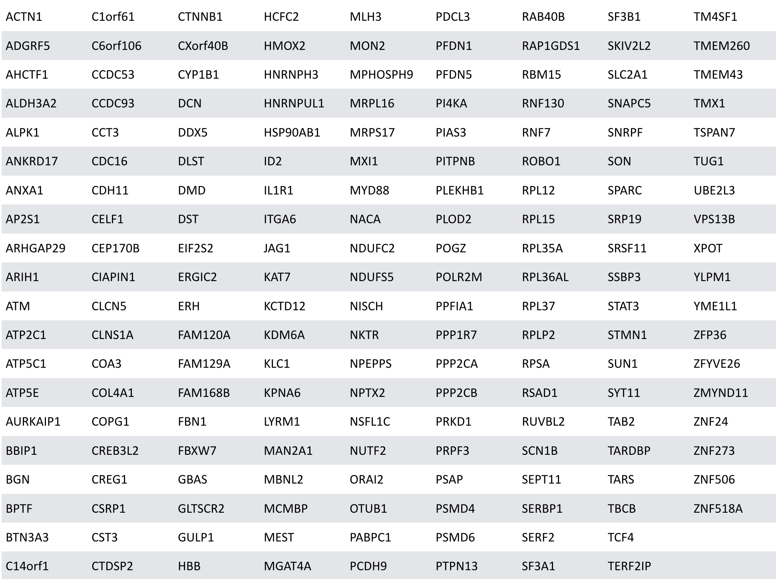
Common DEGs

Slide 5
Top 10 Pathways enriched with 178 DEGs (EnrichR)
KEGG | Wikipathways | Reactome
Ribosome | Cytoplasmic ribosomal proteins | L13a-mediated translational silencing of Ceruloplasmin expression
Arrhythmogenic right ventricular cardiomyopathy | mRNA processing | 3' -UTR-mediated translational regulation
TGF-beta signaling pathway | Wnt signaling pathway and pluripotency | Nonsense-Mediated Decay (NMD)
Spliceosome | Serotonin transporter activity | Eukaryotic Translation Initiation
Ubiquitin mediated proteolysis | Integrated pancreatic cancer pathway | GTP hydrolysis and joining of the 60S ribosomal subunit
NF-kappa B signaling pathway | IL-1 signaling pathway | SRP-dependent cotranslational protein targeting to membrane
Lysine Degradation | Parkin-ubiquitin proteasomal system pathway | Extracellular matrix organization
Huntington’s disease | Estrogen receptor pathway | Viral mRNA Translation
Parkinson’s disease | Dopamine metabolism | Selenoamino acid metabolism
Toxoplasmosis
Notes:
Add slide explaining the datasets put in
Enrichment sig at <.05 p value (unadjusted)
Of KEGG enrichment, TGF…, NF-kappa B, lysine degradation, Hunt, Park, & toxoplasmosis all involve immune response.
Evidence of cardiomyopathy in all sampled ALS cases (Gdynia et al, 2006, PMC2117442)

Slide 6
Top 10 Pathways enriched with 178 DEGs (EnrichR)
KEGG | Wikipathways
Ribosome | Cytoplasmic ribosomal proteins
Arrhythmogenic right ventricular cardiomyopathy | mRNA processing
TGF-beta signaling pathway | Wnt signaling pathway and pluripotency
Spliceosome | Serotonin transporter activity
Ubiquitin mediated proteolysis | Integrated pancreatic cancer pathway
NF-kappa B signaling pathway | IL-1 signaling pathway
Lysine Degradation | Parkin-ubiquitin proteasomal system pathway
Huntington’s disease | Estrogen receptor pathway
Parkinson’s disease | Dopamine metabolism
Toxoplasmosis
Transcription/Translation
Immune Response
Signaling
Protein degradation
Notes:
Add slide explaining the datasets put in
Enrichment sig at <.05 p value (unadjusted)
Of KEGG enrichment, TGF…, NF-kappa B, lysine degradation, Hunt, Park, & toxoplasmosis all involve immune response.
Evidence of cardiomyopathy in all sampled ALS cases (Gdynia et al, 2006, PMC2117442)

Slide 7
Pathprint datasets
Genetic Background | Disease | Platform
C9orf72 | Amyotrophic lateral sclerosis | Microarray
CHMP2B | Amyotrophic lateral sclerosis | Microarray
Sporadic | Amyotrophic lateral sclerosis | Microarray
GRN + Sporadic | Frontotemporal lobar dementia | Microarray
VCP | Inclusion body myopathy | Microarray

Slide 8
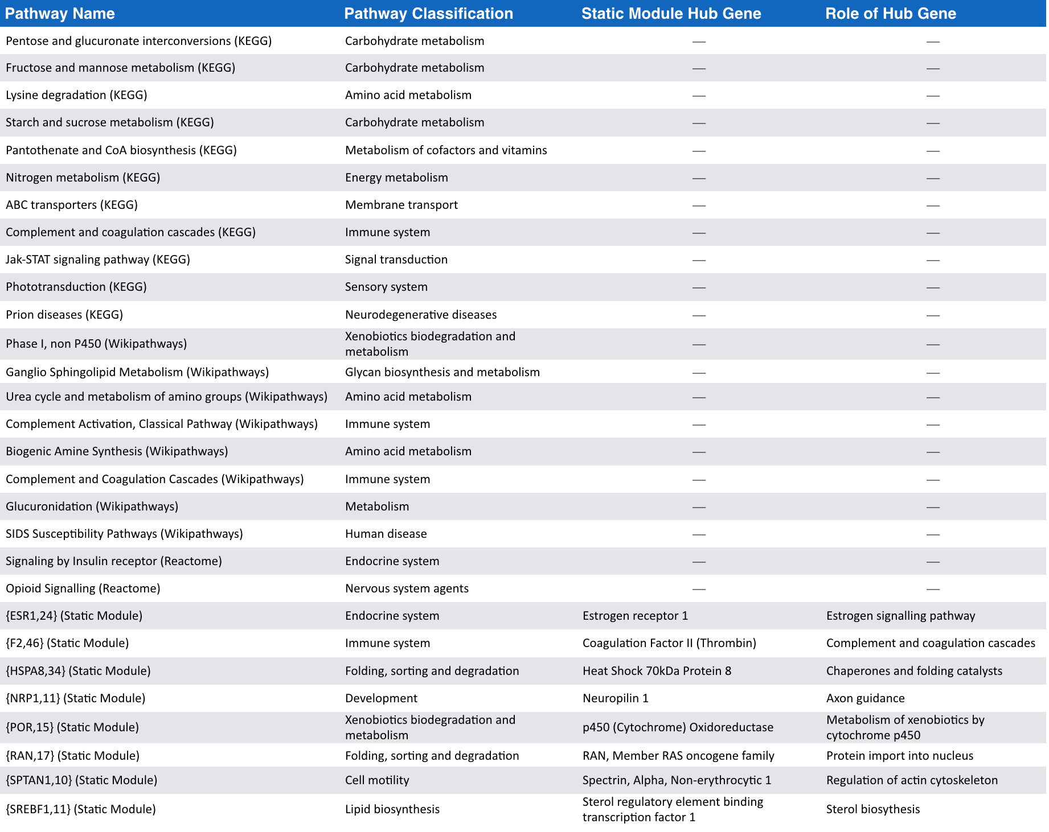
Notes:
JUST AN INFORMATIVE SLIDE FOR PATHWAY DETAILS

Slide 9
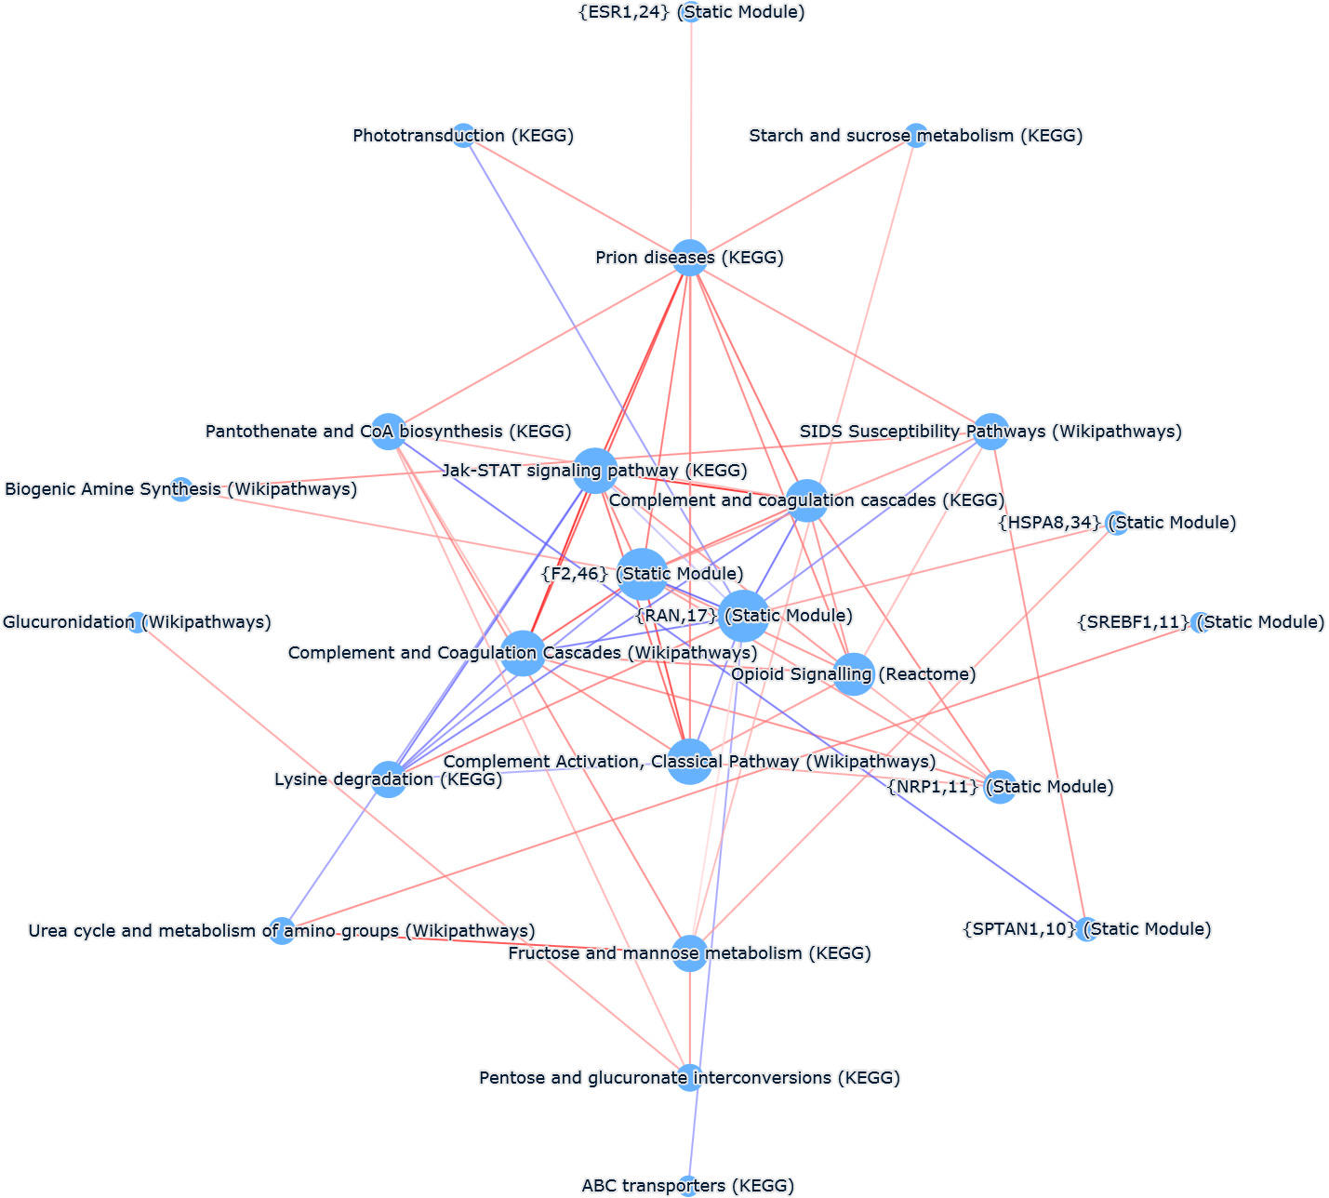
PCxN plot of Pathprint Pathways
Notes:
Yellow area indicates high density coexpression – all pathways involved in immune response
NOTE – lysine degradation and estrogen pathway also present in pathprint output as well as DEG pathway enrichment

Slide 10
Common dysregulated pathways between DEG enrichment and Pathprint result
Lysine degradation
Lysine important for:
Calcium absorption
Muscle development
Hormone production
Estrogen pathways
ALS more common in men
Women, on average, have later onset
Considered neuroprotective

Slide 11
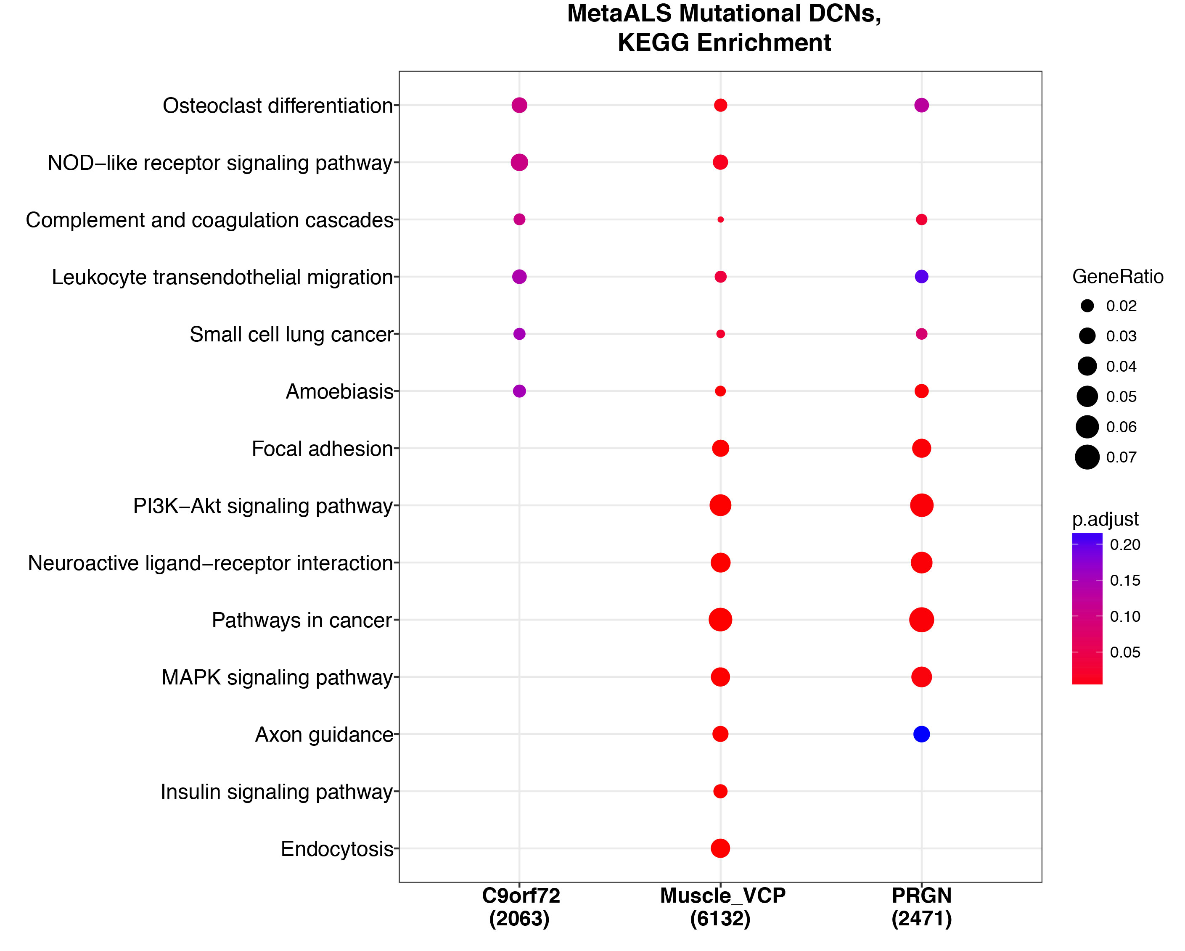
Mutation DCN

Slide 12
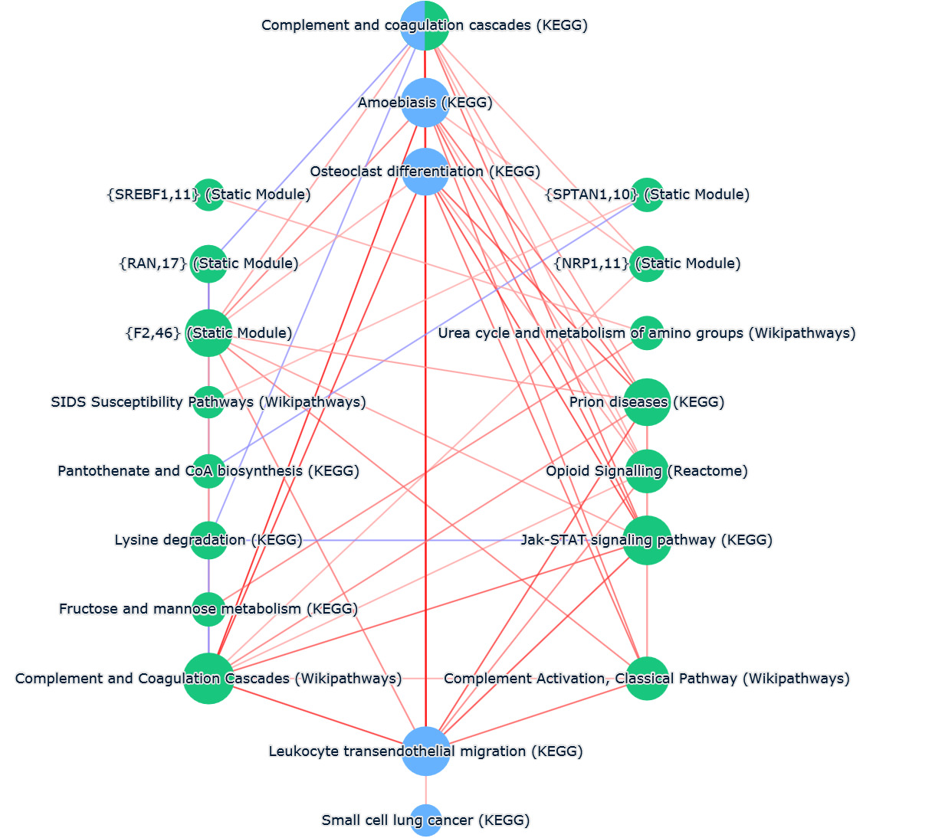
Pathprint + DCN in PCxN
Pathways enriched in DCN
Pathways from Pathprint

Slide 13
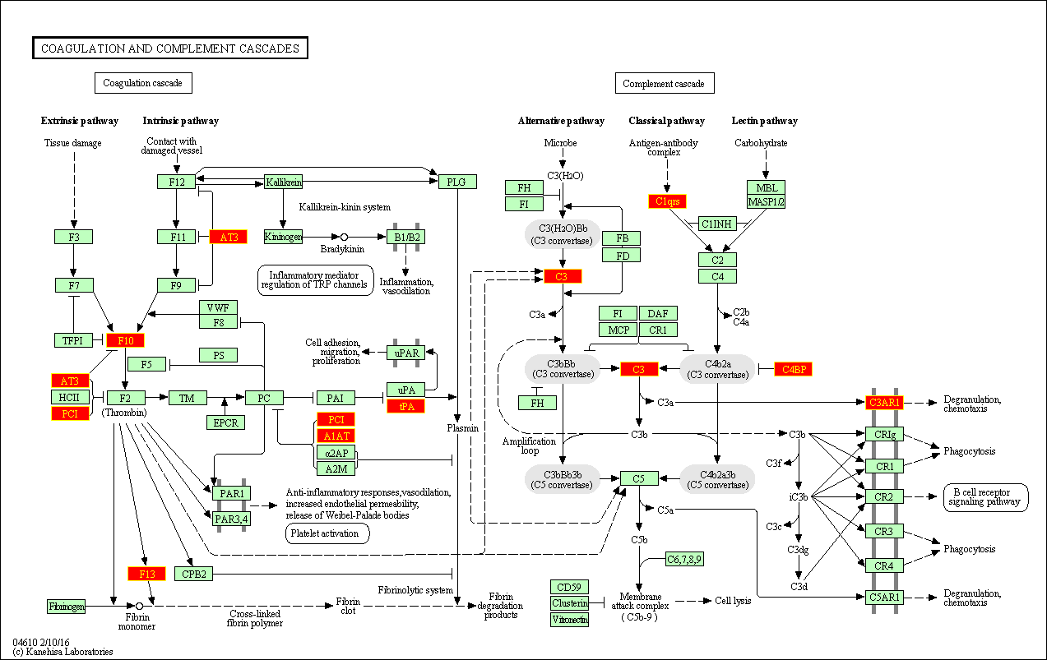
CCC: positively coexpressed rewired genes
C1QA
C1QB
Positively coexpressed rewired genes
Prognostic microglia module
(Cooper-Knock)
Notes:
Significant enrichment of JCK immune network (p = 8.17E-05)

Slide 14
Do top DEGs from each mutation appear in Complement and coagulation cascades pathway?
Took DEGs with p value of < .05 (or top 2000 for VCP as none qualified)
Mapped onto CCC pathway map

Slide 15
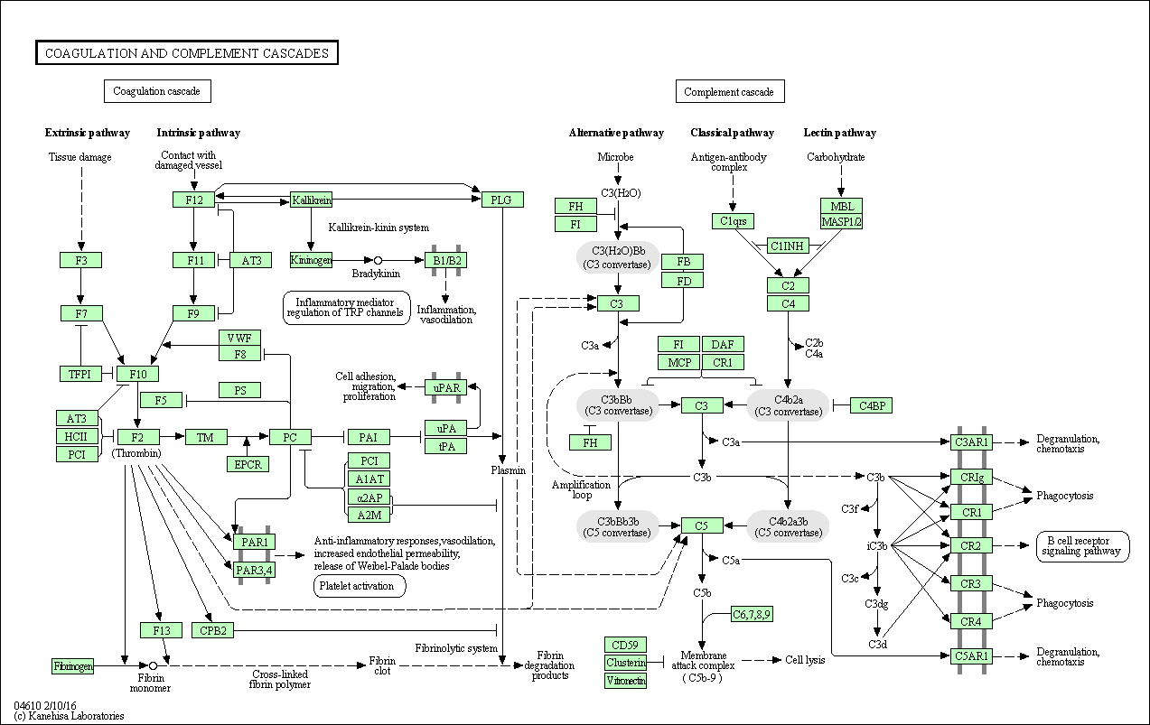
DEGs pValue < .05
GRN
CHMP2B
C9orf72
Top 2000 DEGs
VCP

Slide 16

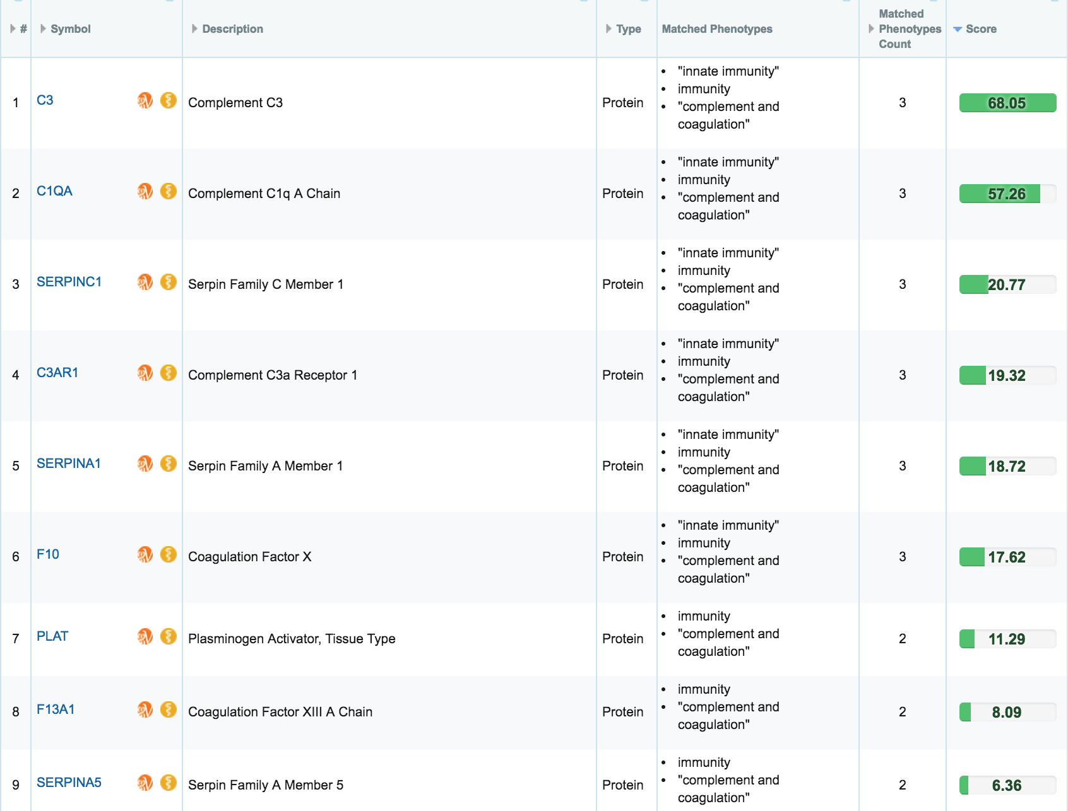

Slide 17
Important points
Immune processes implicated across the board
DEG KEGG enrichment
Pathprint central module
DCN KEGG enrichment
Overlaps
Lysine degradation and estrogen pathway in DEGs and Pathprint
Complement and coagulation cascades in Pathprint and DCN
Enriched with JCK signature
Marked overlap with top DEGs from individual mutation datasets

